Slide 1
Interoperability & EIF4SCC in IoT & Edge: is there a link?
Georges Lobo & Victoria Kalogirou Programme Managers, Interoperability Unit, DG Informatics,European Commission

Slide 2
Interoperability
Interoperability” means the ability of disparate and diverse organisations to interact towards mutually beneficial and agreed common goals, involving the sharing of information and knowledge between the organisations, through the business processes they support, by means of the exchange of data between their respective ICT systems.

Slide 3
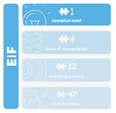
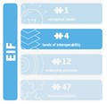
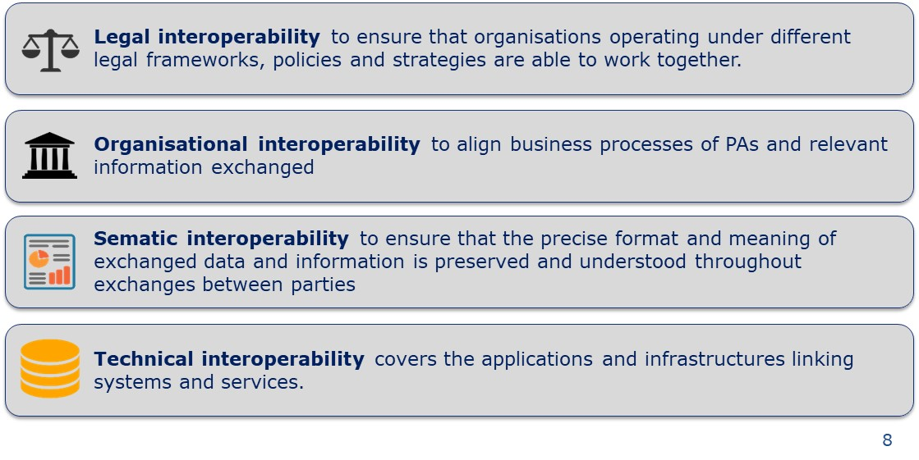
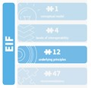
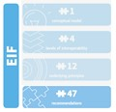
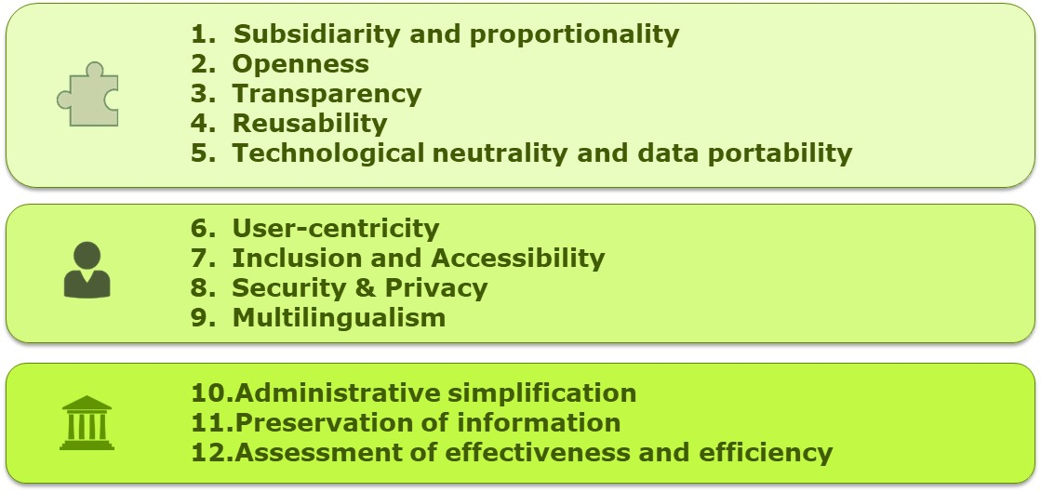
European Interoperability Framework
1 Conceptual Model
4 Layers of interoperability
12 Underlying Principles
47 Recommendations

Slide 4
Interoperability in the public sector

Slide 5
European Interoperability Framework for Smart Cities and Communities – EIF4SCC
Cities & Communities
MIMs +
…
Mobility & transport
Energy & energy efficiency
Water & sanitation
Waste & Resources
Administrative & public services
Safety & Security
Healthcare & well-being
Economic development & housing
Engagement & community
EU Funded Initiatives
…
EU Funded Projects
Local
…
Regional
EIF
National
European

Slide 6
European Interoperability Framework for Smart Cities and Communities – EIF4SCC
A Human-centric approach
A city needs-led approach at EU level
The city as a participatory driven and open innovation ecosystem
Ethical and socially responsible access, use, sharing and management of data
Technologies as key enablers
Interoperability
Smart City/ Community
EIF4SCC
Principles
Elements
Concepts
Technical Interoperability
Cultural Interoperability
Integrated Service Governance
Semantic Interoperability
Legal Interoperability
Organisational Interoperability
Interoperability Governance

Slide 7
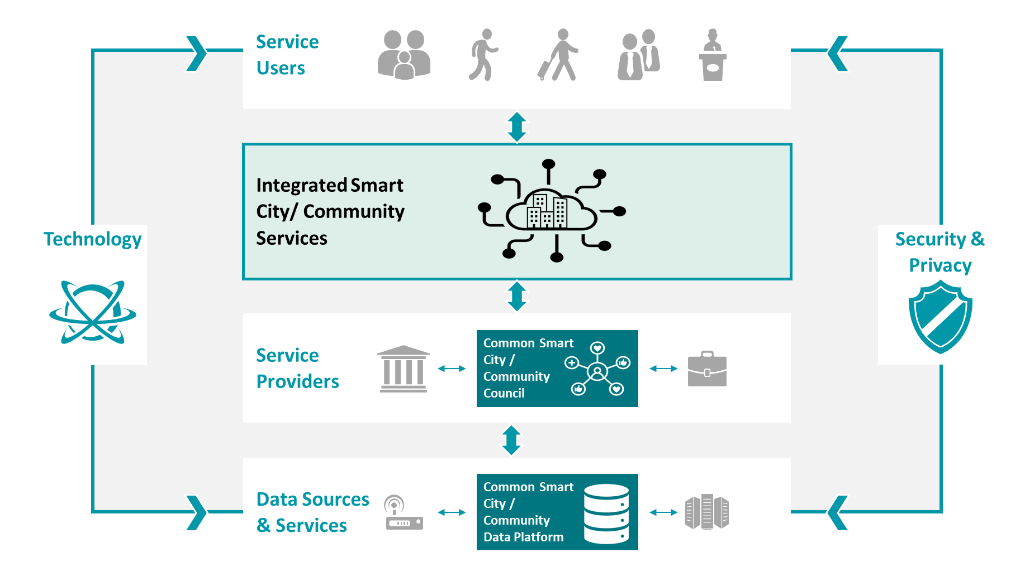
EIF4SCC Conceptual Model
Technical Interoperability
Cultural Interoperability
Integrated Service Governance
Semantic Interoperability
Legal Interoperability
Organisational Interoperability
Interoperability Governance
Principles and Definitions

Slide 8
EIF4SCC Stakeholder Consultation
Your view matter!
available until the 12th of April
[ https://ec.europa.eu/eusurvey/runner/EIF4SCC_Stakeholder_Consultation]
Fill the survey
Share the survey
Lets shape EIF4SCC together!
comment
coceate
Propose ideas

Slide 9
Thank you! ISA² programme You click, we link.
ec.europa.eu/isa2
ISA2@ec.europa.eu
@EU_ISA2
Unit D2 Directorate-General for Informatics
European Commission, Brussels
© European Union 2020
Unless otherwise noted the reuse of this presentation is authorised under the CC BY 4.0 license. For any use or reproduction of elements that are not owned by the EU, permission may need to be sought directly from the respective right holders.
Slide xx: element concerned, source: e.g. Fotolia.com; Slide xx: element concerned, source: e.g. iStock.com
Notes:
Update/add/delete parts of the copy right notice where appropriate.
More information: https://myintracomm.ec.europa.eu/corp/intellectual-property/Documents/2019_Reuse-guidelines%28CC-BY%29.pdf

