Slide 1
Highlights on standardisation developments for IoT and Edge Computing in ITU-T
“IoT and Edge Computing Research and Standardization Convergence“ workshop
Session 1: IoT and Edge Computing Standardization Challenges, 13 Sept 2021
Marco Carugi
ITU-T SG20 Mentor and Q2/20 Rapporteur
Huawei Research Europe
marco.carugi@gmail.com, mobile: +33 6 64047454

Slide 2
How ITU supports IoT and Smart Cities and Communities
Joint IEC-ISO-ITU Smart Cities Task Force
JCA-IoT and SC&C:
Joint Coordination Activity on IoT and Smart Cities and Communities
U4SSC:
United for Smart Sustainable Cities initiative
ITU:
International Telecommunication Union – the UN specialized agency for ICTs
ITU-T Study Group 20:
ITU Study Group on IoT and Smart Cities and Communities

Slide 3
ITU-T standardization activities related to Edge Computing 1
Edge Computing for IoT (ITU-T SG20: IoT and Smart Cities and Communities)
Published Recommendations
ITU-T Y.4208 "IoT requirements for support of edge computing” (approval: 1/2020)
ITU-T Y.4122 “Requirements and capability framework of the edge computing- enabled gateway in the IoT” (approval: 7/2021)
Edge Computing network aspects (ITU-T SG13: Future Networks)
Published Recommendations
ITU-T Y.3109 “QoS assurance-related requirements and framework for virtual reality delivery using mobile edge computing supported by IMT-2020” (approval: 4/2021)
On-going WIs
Y.ec-reqts “Edge computing - Overview and requirements”
Y.ecloud-reqts: “Cloud computing - Functional requirements of edge cloud”
Y.IMT2020-CEFEC “Framework of capability exposure function in edge computing for IMT-2020 networks and beyond”
Y. FMSC-MEC "Multi-access Edge Computing for fixed, mobile and satellite convergence in IMT-2020 networks and beyond”
Y.FMC-EC "Unified edge computing for supporting fixed mobile convergence in IMT-2020 networks”
Y.LSMEC “Local shunting for multi-access edge computing in IMT- 2020 networks”
Y.FMC -AAEC-req “Use cases and Technical requirements for supporting application addressing in edge computing for future networks including IMT-2020 network”
Y.FMC-AAEC: “Application addressing in edge computing in IMT-2020 network and beyond

Slide 4
ITU-T standardization activities related to Edge Computing 2
Edge Computing applications (ITU-T SG16: Multimedia)
Published Recs
F.743.12 Requirements for edge computing in video surveillance
F.743.10 Requirements for mobile edge computing enabled CDNs
H.644.4 Architecture for mobile/multi-access edge computing enabled CDNs
F.749.11 Requirements of civilian unmanned aerial vehicles enabled mobile edge computing
On-going Wis
H.VSECArch Architecture for edge computing platform supporting a video surveillance system
F.DC-CGS-TREC Technical requirements of cloud gaming system for 5G mobile edge computing
F.DVMSF-Edge Distributed vehicular multimedia services framework for V2X based edge computing
Edge Computing security aspects (ITU-T SG17: Security)
On-going WIs
X.gecds “Guideline on edge computing data security”
X.5Gsec-ecs “Security framework for 5G edge computing services”
X.5Gsec-netec “Security capabilities of network layer for 5G edge computing”
X.itssec-5 “Security guidelines for vehicular edge computing”
Edge Computing energy efficiency aspects (ITU-T SG5: Environment, climate change and circular economy)
On-going WIs
L.EEMDC “Energy Efficiency in Micro Data Centre for Edge Computing”

Slide 5
Highlights on IoT related specifications
Basic model of the network for the IoT [ITU-T Y.4113] showing IoT technical components
IoT challenges
IoT network issues [Y.4113]: packet loss and high latency; unreliability of short-range radio communications in the IoT area network; network overload; edge deployment issues (incl. need of enhanced capabilities of the IoT technical components at the edge; coordination of different IoT technical components and assignment of computation, storage and network resources)
Data ecosystem issues [Y.4114]: fulfilment of different service requirements; interoperability; scalability and flexibility; efficient usage of IoT data; big data issues (incl. local and remote collection, pre-processing, storage, querying, analysis, transfer and visualization cross IoT data sources, IoT platform(s) and application server(s); assignment of big data processing tasks to different IoT technical components)
[Y.4208] IoT requirements for support of Edge Computing (EC)
EC helps in reducing data overload and enabling more flexible service provisioning. NOTE – Y.4208 has not addressed security and privacy aspects.
Requirements for enablement of EC capabilities in IoT: Service Requirements for the IoT technical components according to deployment perspective [Y.4401]; Functional Requirements according to IoT common requirements categories [Y.4100] (data management, service provisioning, application support, management)
[Y.4122] EC enabled gateway in IoT (IoT gateway [Y.4101] with additional EC support)
Gateway’s EC capabilities according to the following categories: protocol translation, data processing, remote updating, network support, management

Slide 6
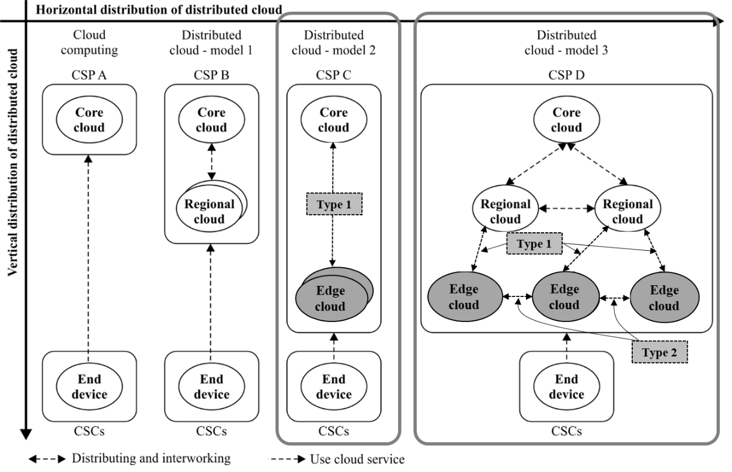
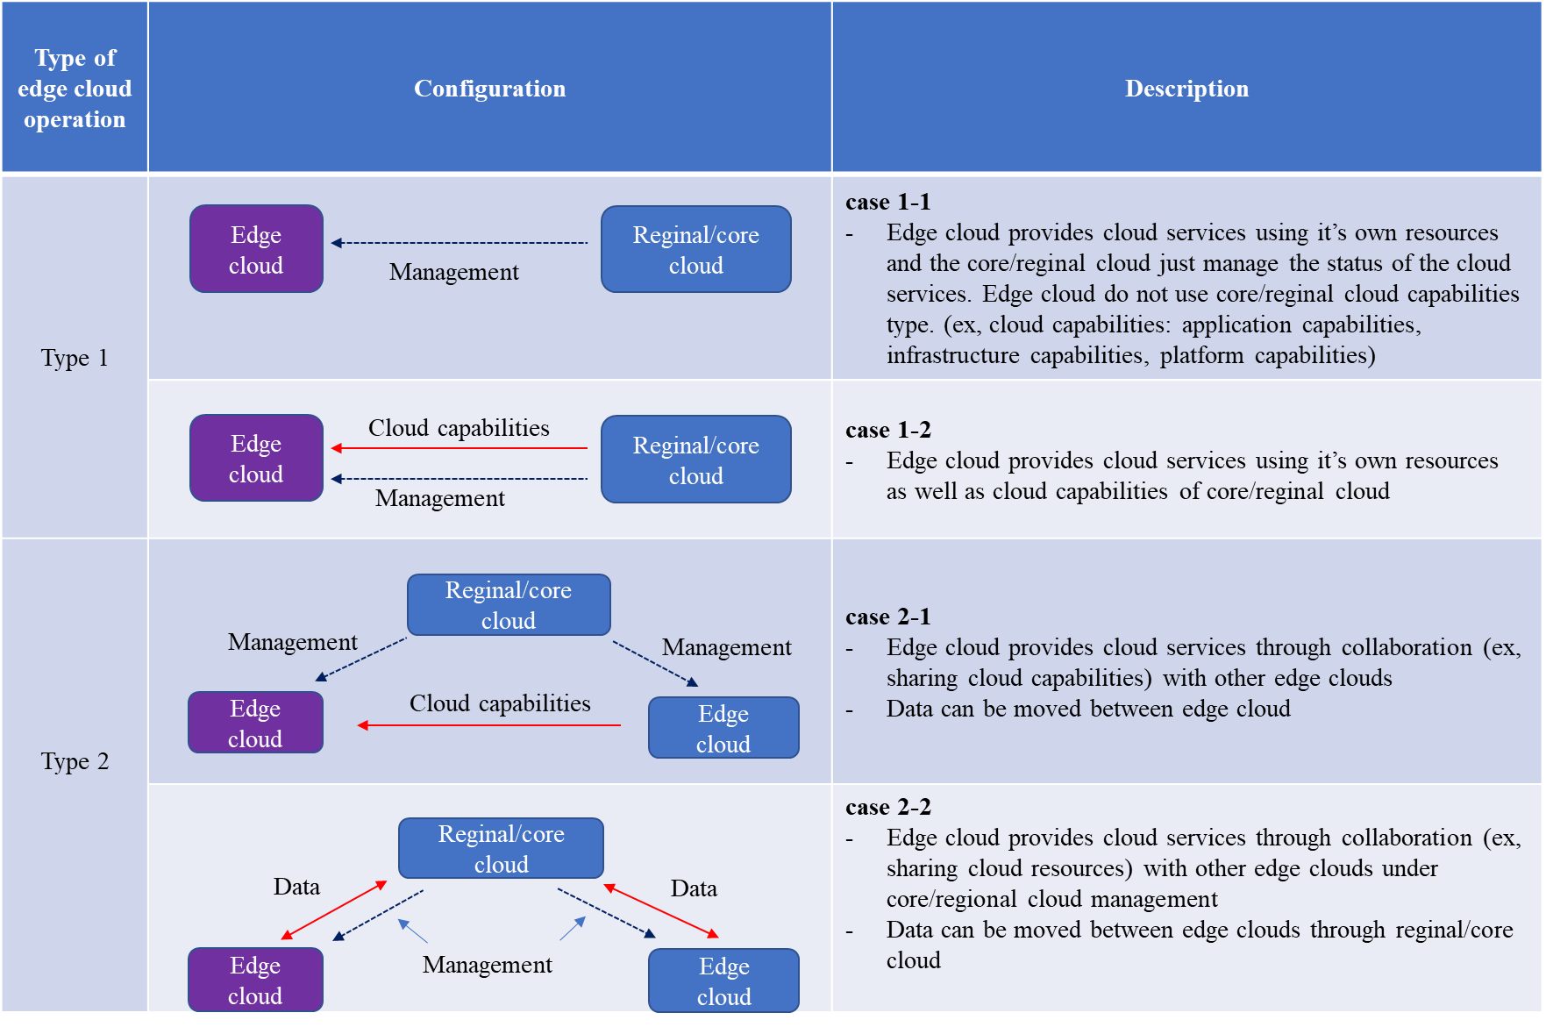
Highlights on network aspects related specifications - 1
Edge cloud (ongoing draft Y.ecloud-reqts)
Positioning and types of operation of an Edge cloud
edge cloud [IUT-T Y.3508]: A cloud computing deployed to the edge of the network accessed by cloud service customers (CSCs) with small capacity resources enabling cloud service.
NOTE 1 – Enabled cloud service on the edge cloud is lightweight cloud service provided by a cloud service provider (CSP) depending on cloud service category.
NOTE 2 – Lightweight cloud service refers to a portion of cloud service to reconfigure the functionality of cloud service to fit on edge cloud, such as base station and gateway with small capacity resource.

Slide 7
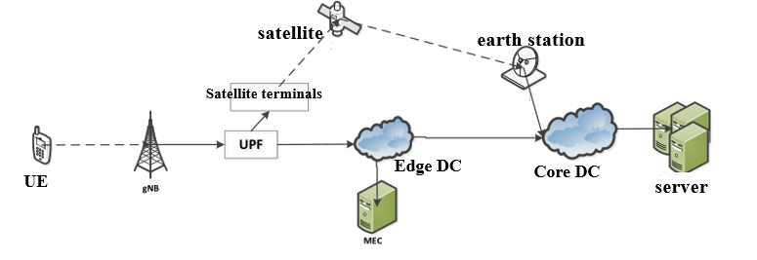
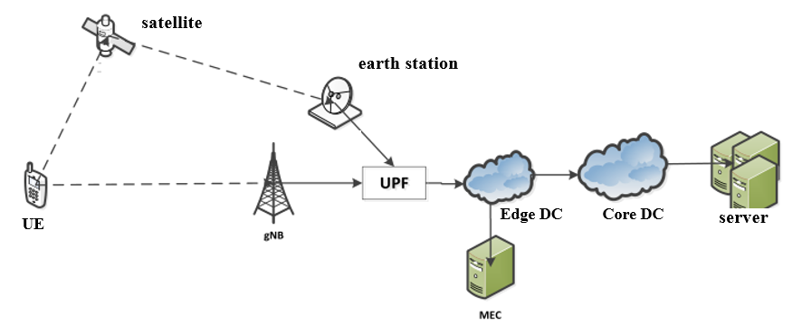
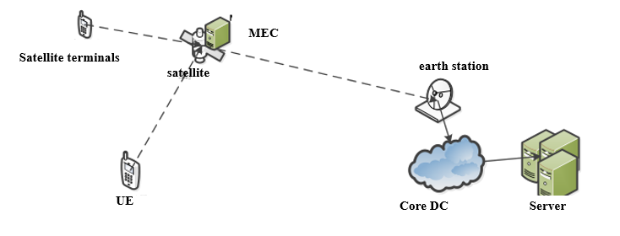
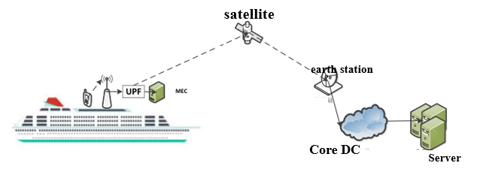
Highlights on network aspects related specifications - 2
Multi-access Edge Computing (MEC) for fixed, mobile and satellite convergence in IMT-2020 networks and beyond (ongoing draft Y.FMSC-MEC)
MEC example scenarios
Ground MEC converged networking: RAN side satellite access converged terrestrial MEC
Ground MEC converged networking: Core network satellite backhaul converged terrestrial MEC
Satellite borne MEC converged networking: RAN side accesses the MEC network on the satellite
Shipborne MEC converged networking

Slide 8
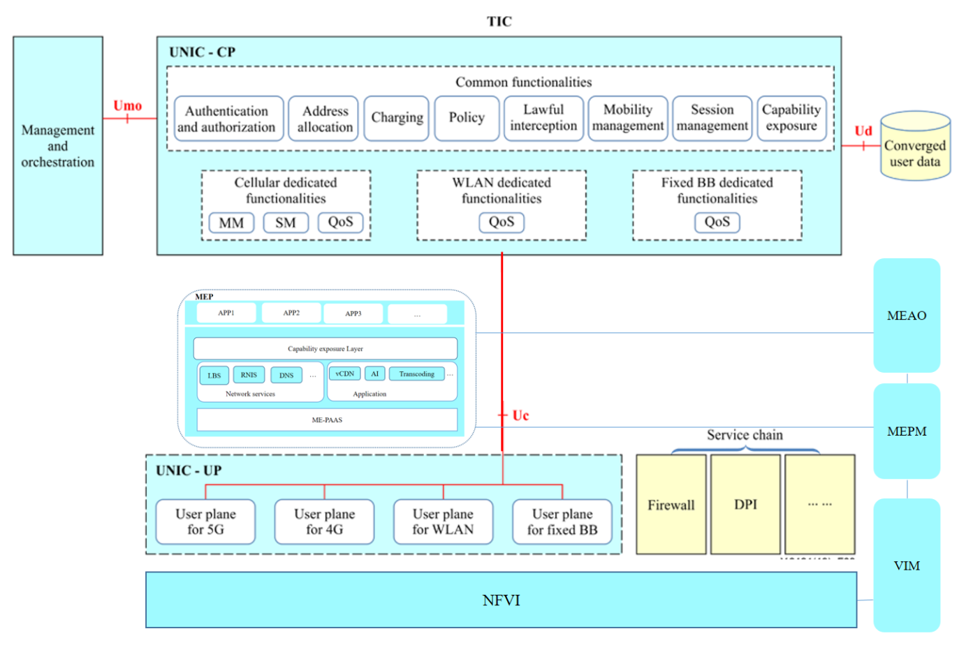
Highlights on network aspects related specifications - 3
Unified Multi-access Edge Computing for supporting fixed mobile convergence (FMC) in IMT-2020 networks (ongoing draft Y.FMC-EC)
Draft
Architecture of unified MEC in IMT-2020 FMC networks
Building on Y.3131 “Functional architecture for supporting fixed mobile convergence in IMT-2020 networks” (2019) NOTE - UNIC: unified network integrated cloud

Slide 9
Application of AI/Machine Learning to Edge Computing – study example
Demand forecasting and live service migration methods in edge computing systems (from ongoing deliverable “Use Cases for Autonomous Networks (AN)” of the ITU-T Focus Group on AN)
Problem statement: Virtualization and cloudification of services have enabled automation, flexible placement and programmability to network topology. Efficiency of service delivery can be significantly improved using these techniques. However, there are significant challenges to host Ultra-reliable low-latency communication (URLLC) and massive machine type communications (mMTC) services in 5G, in centralized topologies. Monitoring of networks by telco operators have revealed that network topology is not static and load is not uniform over a long service time.
The use case describes a dynamic network topology and service placement using the Genetic Algorithm to analyze and predict services, as well as an efficient forecasting and live service migration method as an application to edge computing systems
The approach can enable intelligent allocation of network equipment resources towards flexible and efficient topologies (according to simulation based analysis)
The optimization of mobile edge computing network performance for a service by addressing the service placement problem is described

