Slide 1
An strategic approach towards standardization in IoT and Edge Computing
Juanjo Hierro
CTO
FIWARE Foundation
email: juanjose.hierro@fiware.org

Slide 2
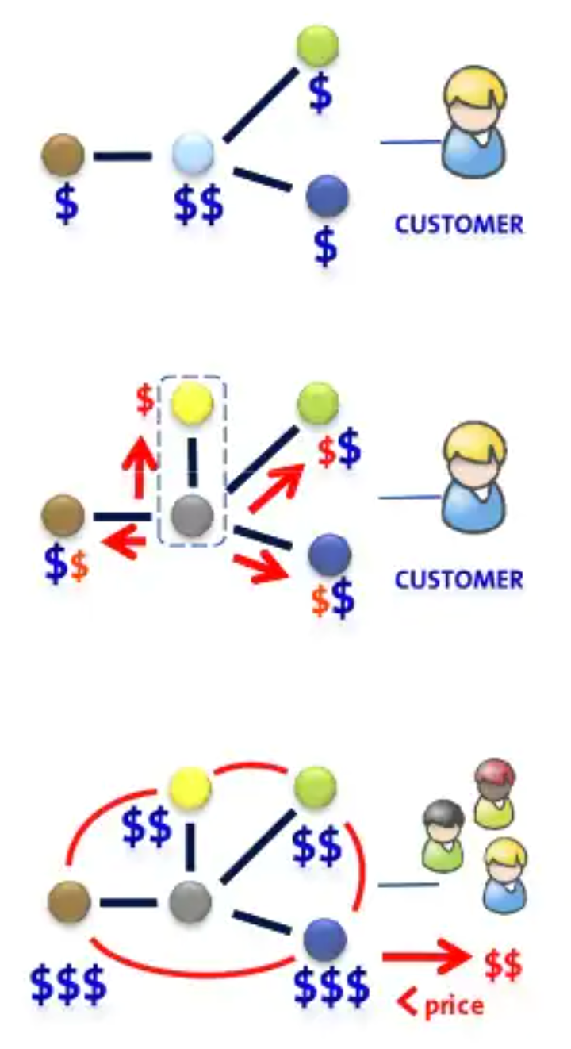
Understanding the economics behind creation of standards following an open source approach
Christensen’s law help to explain how development of standards following an open source approach may be used as a strategic weapon:
Law of Conservation of Attractive Profits
When attractive profits disappear at one stage in the value chain because a product becomes modular and commoditized, the opportunity to earn attractive profits with proprietary products will usually emerge at an adjacent stage.
Clayton Christensen The innovator’s dilemma, Harvard Business Review, Feb 2004
Companies can join forces towards commoditization of products / services in the value chain through the development of standards using an open source approach
Part of the transferred profits may be transferred to end users through price discounts, activating market demand

Slide 3
IoT is mostly a mean for digitizing the world to manage
Process / Analyze / Monitor
Smart Solutions can be designed around management of a “digital twin representation” of the real world which is constantly analyzed and processed in order to automate processes or bring support to smart decisions
Digital Twin = Digital representation of a real-world entity
Characterized by attributes
Properties
Relationships → Linked Data
Values of attributes may change over time (or not)
Typically have a location (but it is not a must requirement)
IoT devices provides the means for capturing (through IoT protocols) the values of certain attributes – what concrete IoT protocol is used is should be irrelevant, transparent to applications
notify / query
update
Digital Twin representation
update
actuation
IoT devices

Slide 4
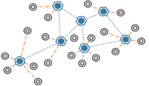
Digital Twins: an approach for integration at multiple levels
Integrating systems and data within organizations (system of systems)
Architecting Smart Solutions
Sharing Data across organizations (Data Spaces)
System 1
Smart City
System 2
Smart Building
Smart Solution
Digital Twin representation
Digital Twin representation
Digital Twin representation
System 3
Smart Grid
System 4
Smart Hospital
3rd systems
IoT devices

Slide 5
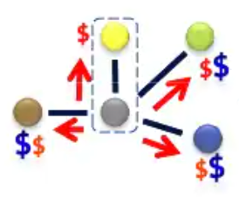
Standardization should focus on the Digital Twin platform
Europe is capable to perform well at two levels:
Solution integrators
IoT device providers (hw & sw)
There are no strong cloud platform providers in Europe
Therefore, focus should be in commoditizing the software for the digital twin platform
Essential elements for standardization:
Standard Digital Twin API to access Digital Twin data
Common Data Models associated to Digital Twin classes
Identity and Access Management framework
That is what FIWARE is about!
data center provider
solution integrators
IoT device manufacturers
digital twin platform provider
application providers

Slide 6
Digital Twin API: ETSI NGSI-LD
NGSI-LD is a simple yet powerful REST API
Simple: simple operations are rather simple, what you would expect in a RESTful API
Entity types, entities, attributes have a path
standard GET, POST, PUT, PATCH, DELETE
Yet powerful: powerful operations supported
Geo-queries
Subscription / Notification
Pull/Push styles for gathering data
Multiple data ”renderings” (key value, normalized, GeoJSON)
Temporal operations
New features to support:
Federation in highly-distributed architectures (cloud ←→ edge)
Non-restful bindings
Fast injection of data
Application/Service
ETSI NGSI-LD API
Context Broker
Wind Turbine
location
power
wind speed
pitch angle
Smart Home
location
address
installed PV
energy consumption
Wind Plant
Location
Active Power
Reactive Power
Frequency

Slide 7
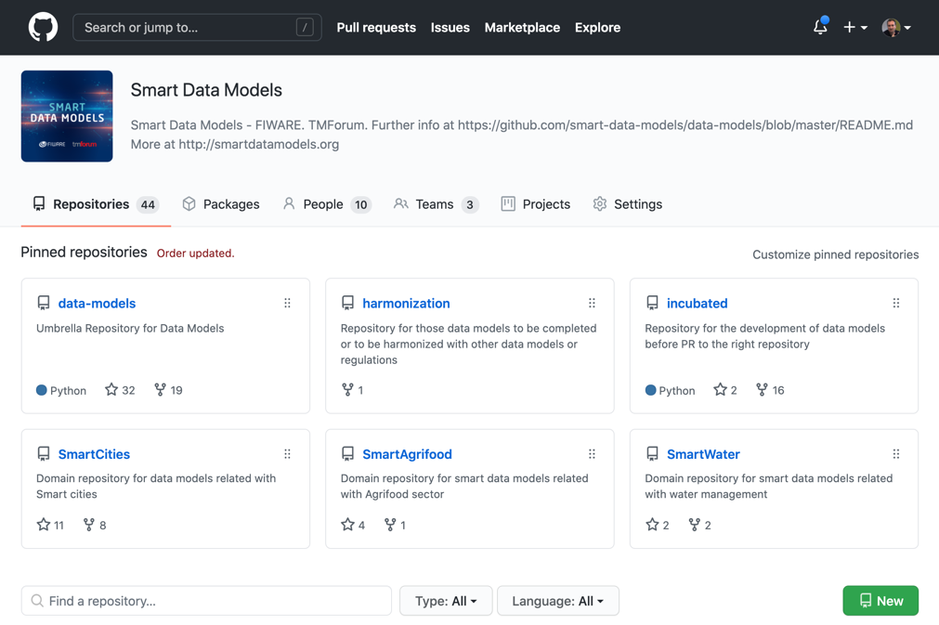
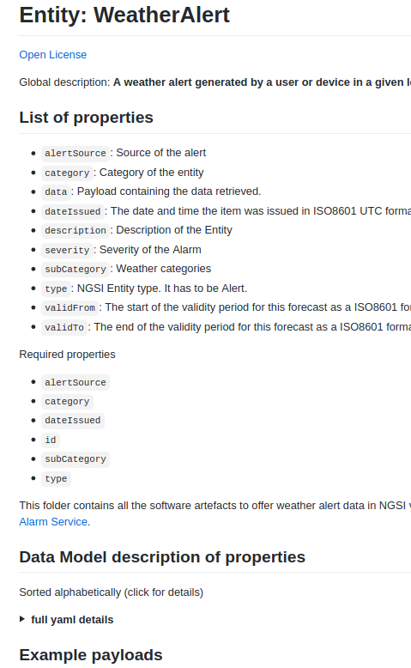
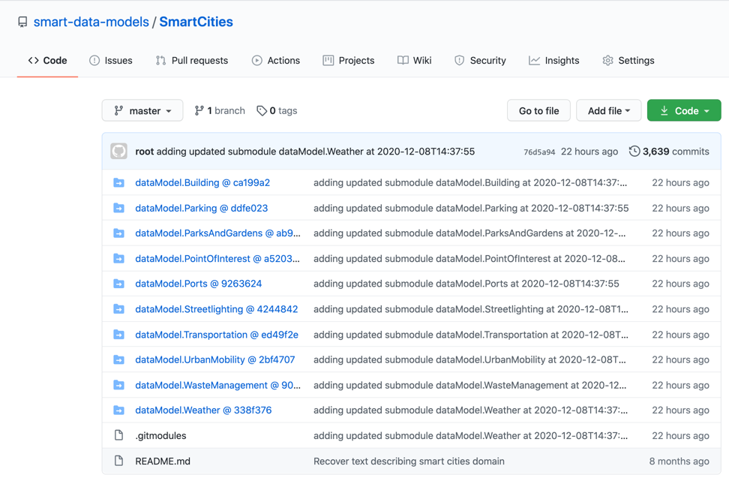
Digital Twin models: Smart Data Models initiative
https://github.com/smart-data-models
FIWARE Foundation is collaborating with relevant organizations (TM Forum, IUDX, OASC) towards definition of common data models for multiple application domains
Smart Cities
Smart Health
Smart Energy
Smart Environment
Smart Manufacturing
…
Defined data models rely on well-established ”de-facto” standards (e.g., schema.org, SAREF, IEC CIM in Energy or UNE 178503 for Tourism)

Slide 8
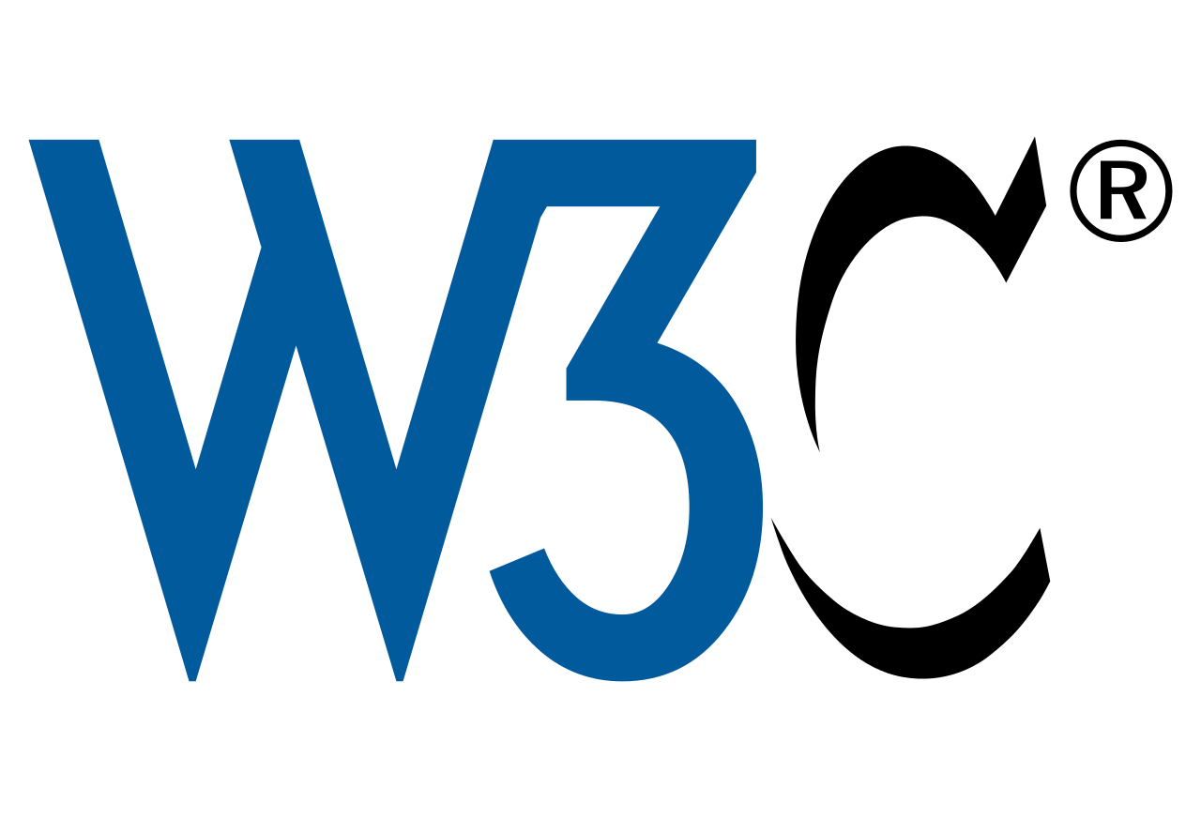
Security and Trust
Identity and Access Control needs to be handled:
At organization level (participants)
At the level of users of applications within organizations
Challenge is to integrate consolidated with emerging standards:
Oauth 2.0 / OpenId Connect
Standards for description of policies (XACML, …)
SSI / DID
…
How / where to integrate Distributed Ledger Technologies in the cocktail

Slide 9
Conclusions / remarks
We should adopt a strategic approach when defining a strategic direction towards commoditization (standardization following an open source approach)
We see the battlefield around the topic of Digital Twins
There is good basis to rely on:
ETSI NGSI-LD
Smart Data Models initative
Opportunity make progress leveraging Horizon Europe and Digital Europe
Digital Twin on the Edge – Highly distributed systems
Security and Trust

